Slide 1
How to Make a
FACS Diva Template

Slide 2
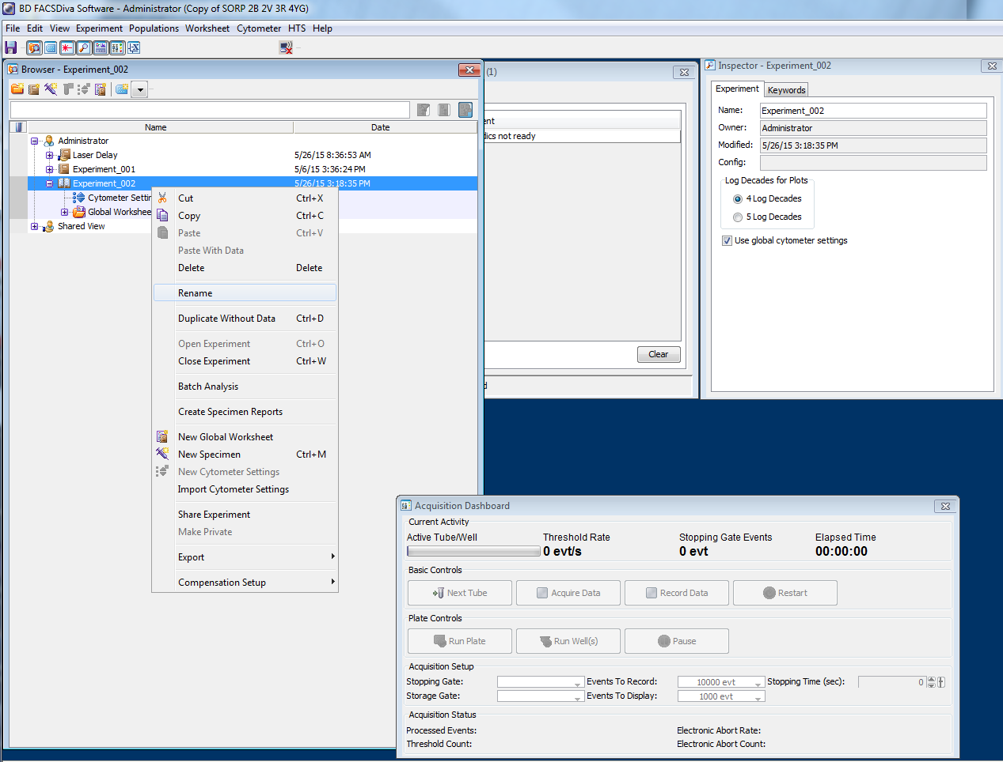
Click new experiment and rename it

Slide 3
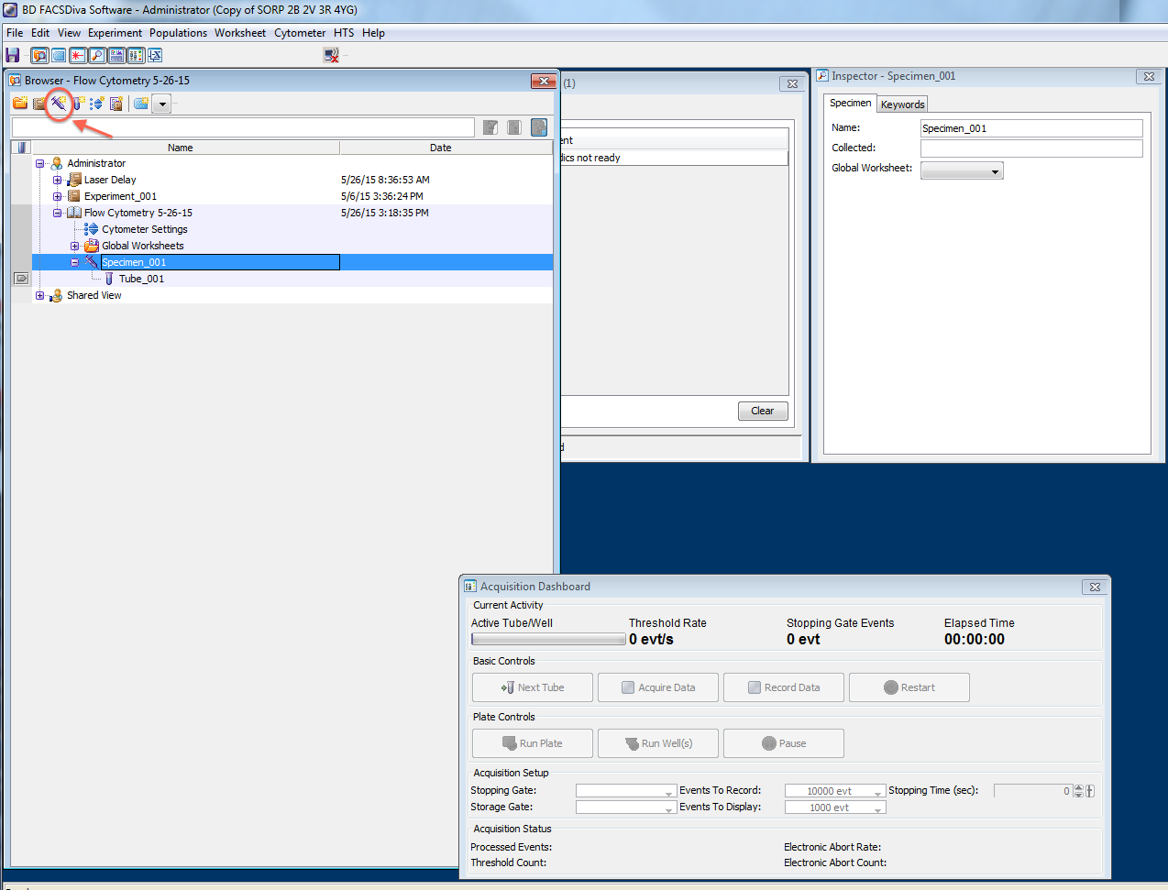
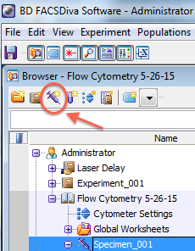
Click new specimen
Right click, pull down rename and rename the specimen today’s date

Slide 4
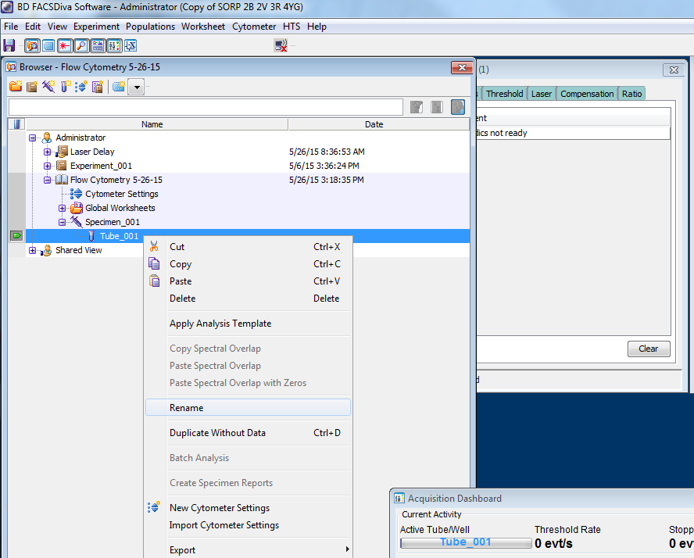

Click the plus button next to the specimen. Make the button to the left of the file name green by clicking it. Then right click on the tube and rename it

Slide 5
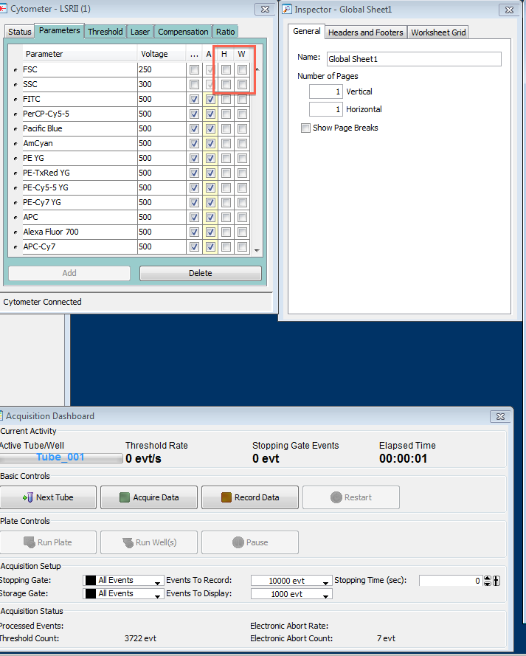
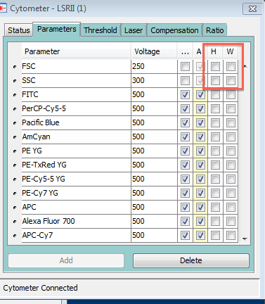
In the Cytometer window, click the Parameters tab and make sure FSC A,H,W and SSC A,H,W are checked

Slide 6
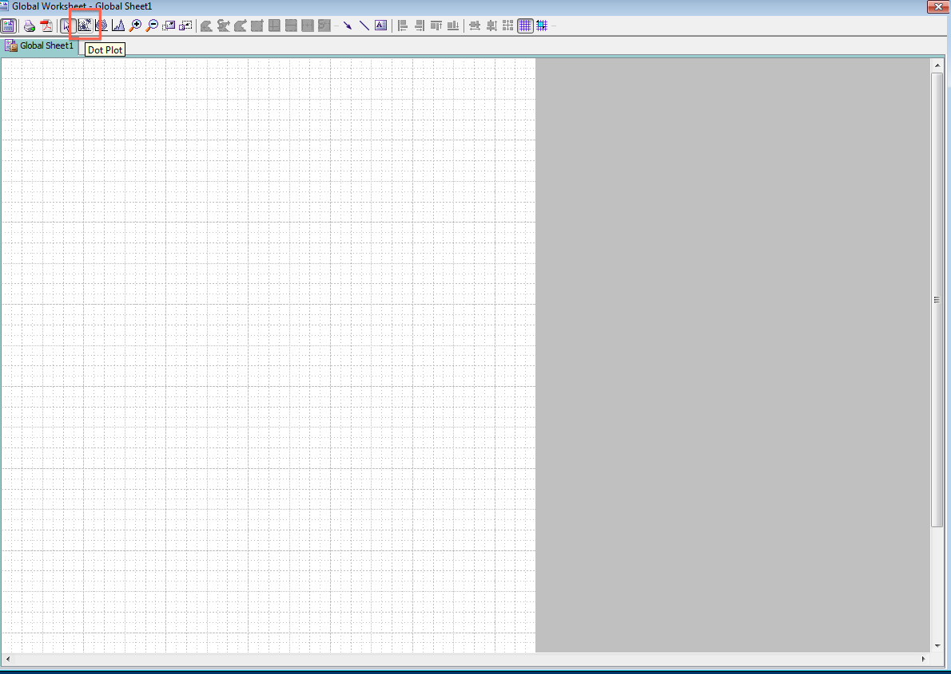

Left click on the graph then left click on the global worksheet page

Slide 7
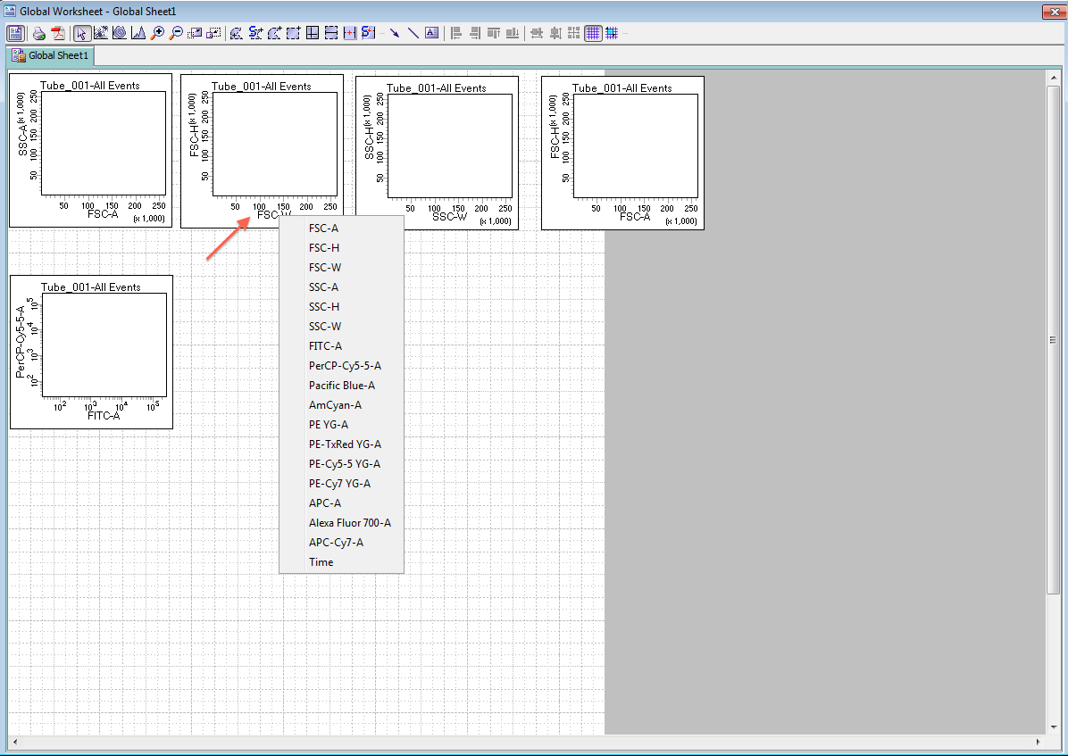
Make four of these graphs on the first row and one of these graphs on the second row

Slide 8
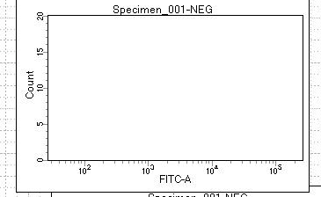
Click the histogram plot and click the global worksheet page
Make a histogram plot for each fluorophore you are using.

Slide 9
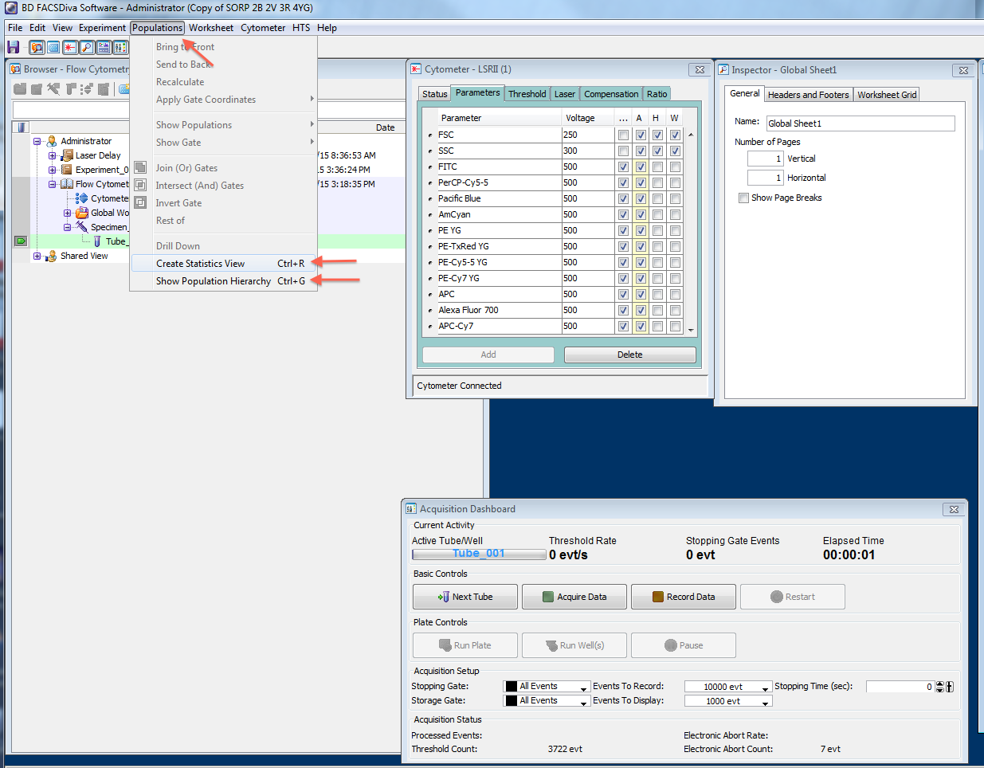
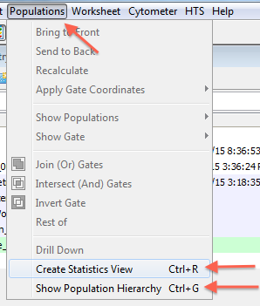
Create a statistic view window by going to population menu> statistic view

Slide 10
Make a population hierarchy window by going to the population menu> population hierarchy

Slide 11
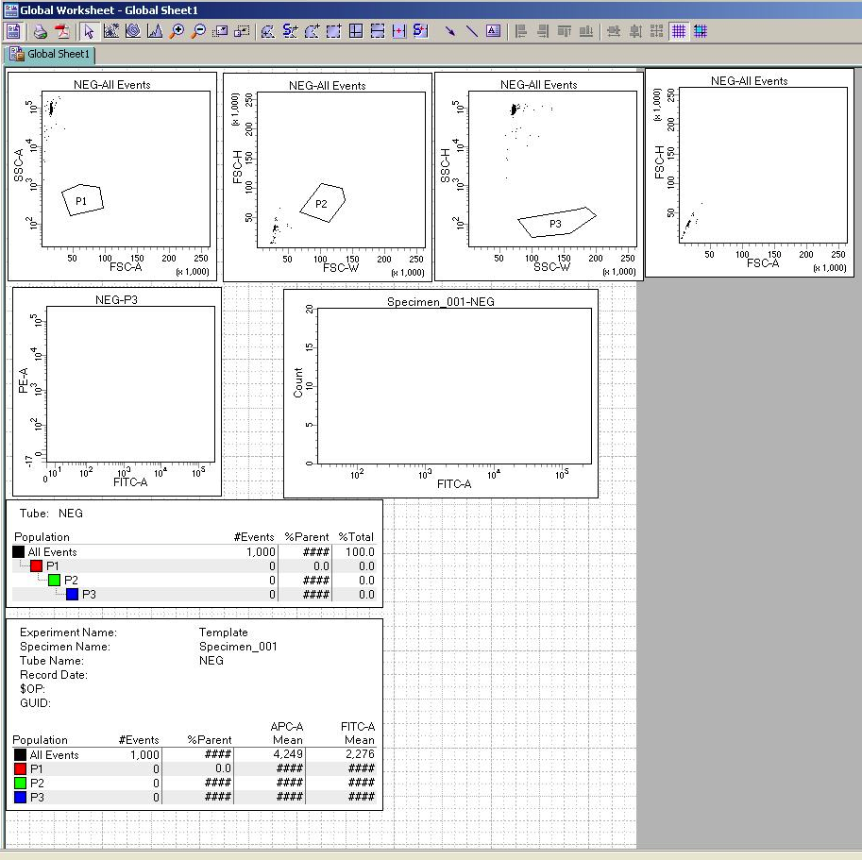
Check your graphs axis against the example page

Slide 12
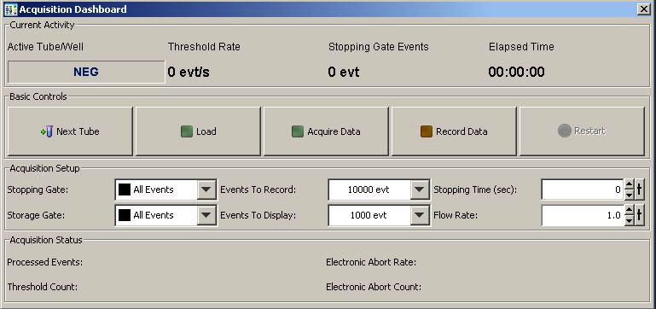
Have the flow rate start at 1 and make sure the tube arrow is highlighted green

Slide 13
Load the tube

Slide 14
If the event rate is low (0-500) increase the flow rate, but NEVER go above 6.0

Slide 15
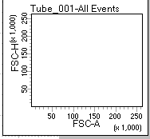
On Cytometer Window, adjust the FSC Area Scaling so that the cells fall on a 45° angle on the FSC-A vs. FSC-H

Slide 16
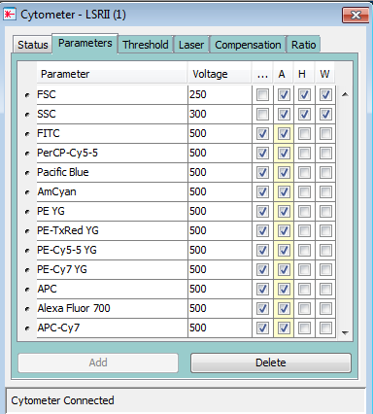
On the FSC-A vs. SSC-A plot try to keep the cells at 100
To change where your cells are, adjust the FSC and SSC voltages in the parameters tab
It is best to hold down the control key while doing so to go 10 at a time instead of 1 by 1

Slide 17
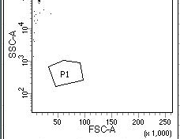
Once the cells are in the proper place click on the polygon tool and click around the population on the first graph, and double click to close the polygon. This is P1.

Slide 18
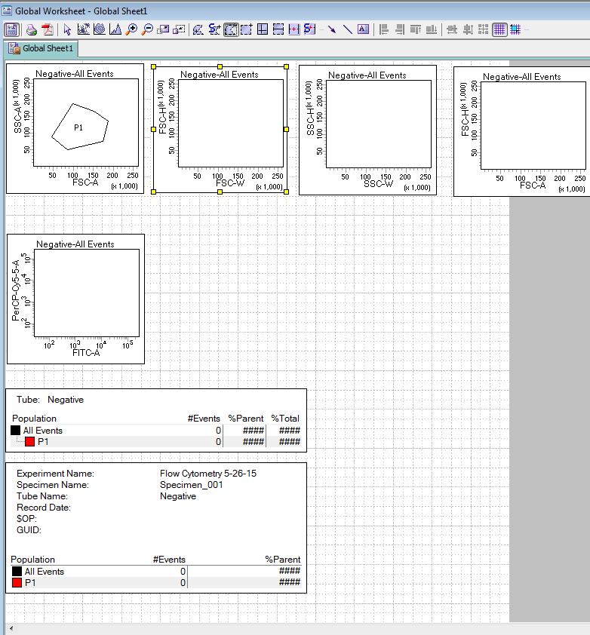

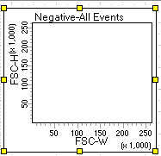
On the population hierarchy window click P1. On the FSC-W vs. FSC-H plot use the polygon tool and make a P2 region in the second graph

Slide 19

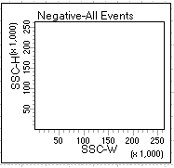
Click on P2 in the population hierarchy window. Then the polygon tool and make a P3 region on the SSC-W vs. SSC-H graph

Slide 20
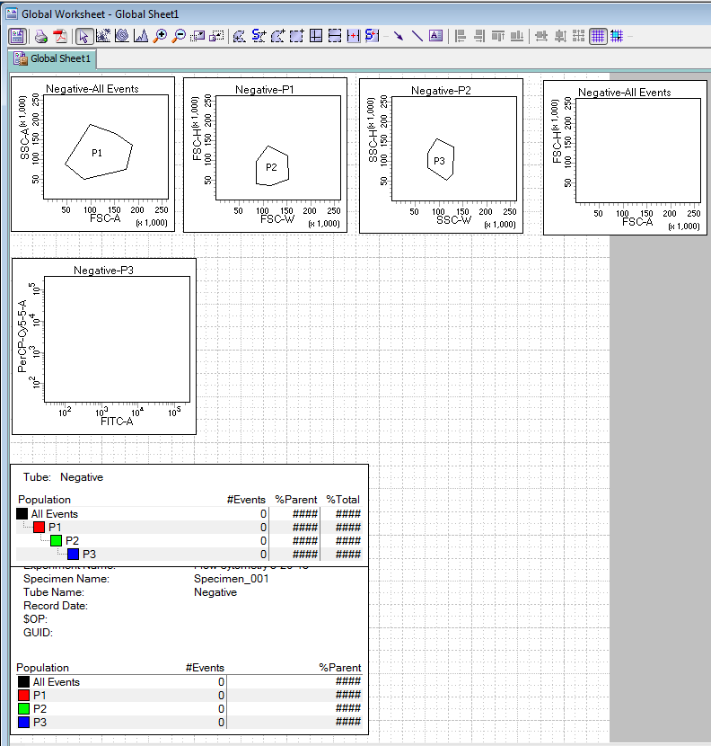
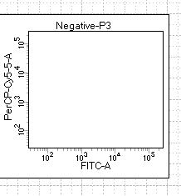
Now look at the fluorophore graph. The voltage of a fluorophore should be set using your single color control and the voltage should be adjusted so that the positive cells fall at 10⁵ on the axis
This is where a Fitc control would be set to

Slide 21
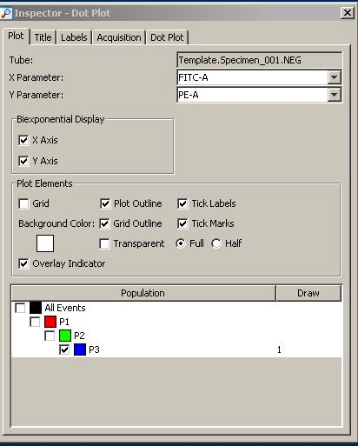
Instead of seeing all events it would be simpler to just see the live cells so click on the dot plot or histogram plot, go to the inspector window and click the plot tab,then go to the population and gate this graph on the P3 population

Slide 22
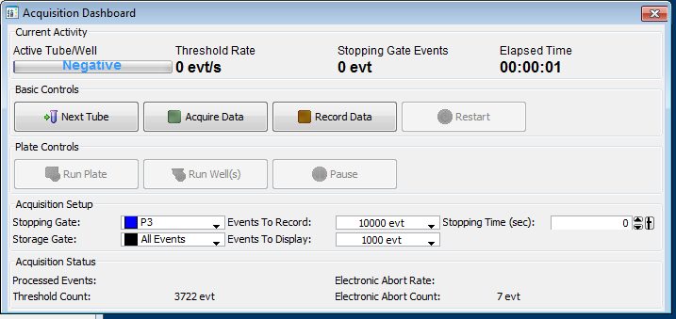
Set your stop gate to an appropriate number gated on P3.
The error is equal to the square root of the number of cells collected divided by the number of cells collected
Ex. √10,000/10,000=100/10,000=1% error
If sample 1 has 10% positive and sample 2 has 11% positive there is no significant difference

Slide 23

Now press record

Slide 24
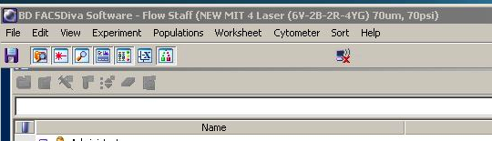
Click unload, and then do a sample line backflush
Go to cytometer >clean modes > sample line backflush

